Slide 1
NBA Historical Efficiency Analysis
Carson Mallen

Slide 2
Broad Overview
Research Questions:
How has efficiency in stats changed in the NBA from 1980 to present?
Are modern NBA teams more efficient than earlier eras?
Key Discoveries:
Both offensive and defensive ratings have increased overtime
Modern NBA teams are statistically much more efficient than past eras when adjusted for pace
Efficiency gains are tied to changes in play style and strategy
Key Takeaways:
The NBA has shifted to a faster, spacing-based, analytics-driven style of play
Efficiency improvements are driven by shot selection rather than scoring volume
Modern NBA prioritizes high-value shots (three-pointers, easy finishes at the basket)

Slide 3
Raw Data
Data Source:
Collected using Basketball Reference
Covers NBA 1980 to present year
Collection Method:
Web scraped by parsing HTML tables
Converted raw data into structured JSON format
Cleaned and exported final data sets as CSV files
Organized data for both league and team level analysis
Available Data:
Season-level NBA statistics (1980 - 2026)
Team offensive and defensive performance metrics
Possession based stats (pace, turnover, rebounds)
Shooting efficiency data
League wide averages for each season

Slide 4
Processing Data
Data Cleaning:
Removed missing or incomplete season records
Standardized column names across datasets
Converted scraped text values into numeric formats
Data Collected:
Offensive Rating (ORtg): Scoring efficiency per 100 possessions
Defensive Rating (DRtg): Points allowed per 100 possessions
Net Rating (NRtg): Overall team performance
Pace: Possessions per game (speed context)
Efficiency metrics (TS%, eFG%, turnover %, rebounding %, FT rate)

Slide 5
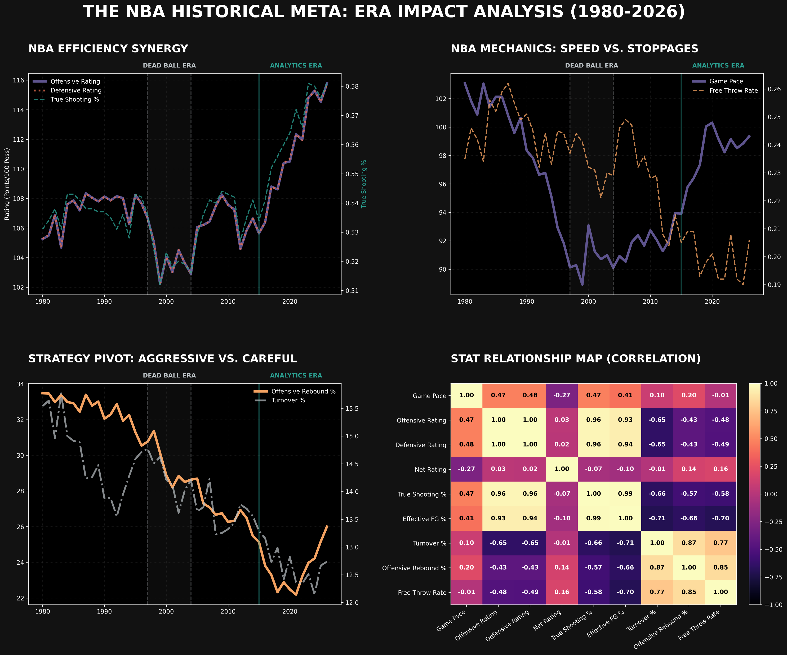
League Based Visualization

Slide 6
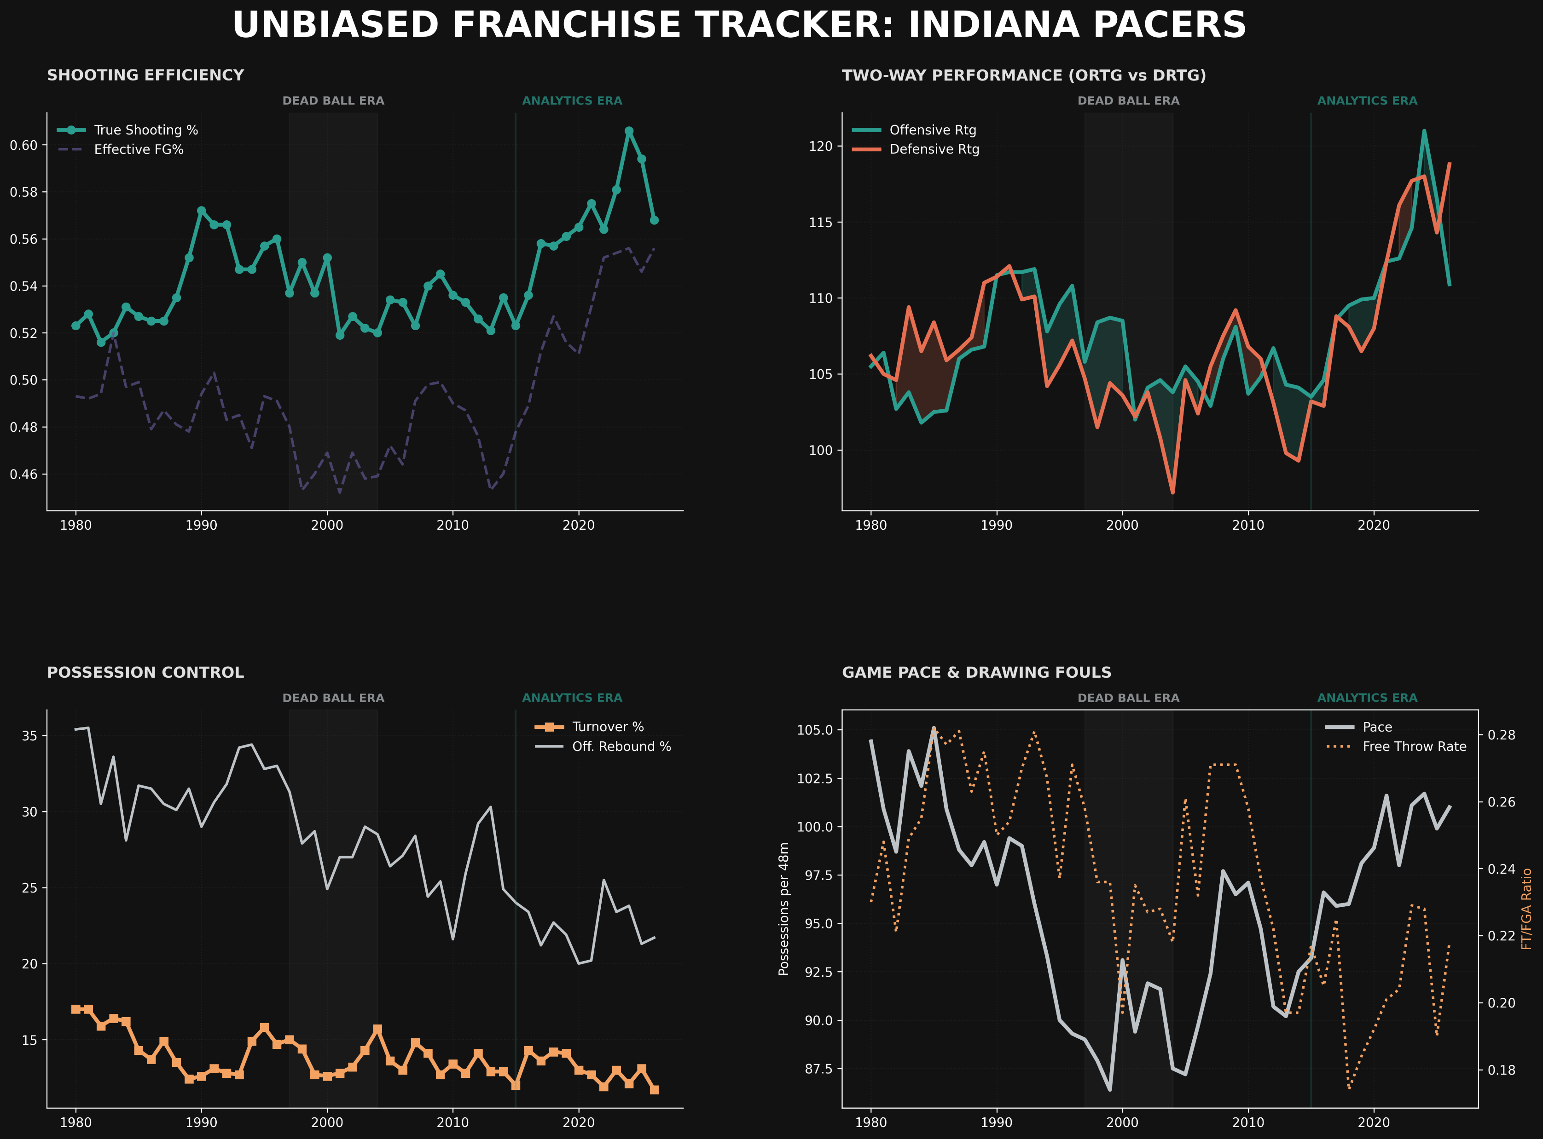
Team Based Visualization

Slide 7
Conclusions
Findings:
Both offensive and defensive efficiency in the NBA have improved over time during the analytics era
The increased emphasis on the three-point shot and analytics-driven decision-making has shifted teams toward more statistically efficient shot selection (e.g., 3-pointers and shots at the rim)
As offensive efficiency has increased, defenses have adapted by prioritizing perimeter contesting and spacing control rather than solely interior defense
Improvements:
Incorporate player-level data to capture individual contributions to efficiency changes
Expand analysis using predictive modeling to forecast future trends in offensive/defensive efficiency
Compare playoff vs. regular season efficiency to identify differences in defensive intensity and shot selection under pressure

